Slide 1
Car Rental System
Submitted in the partial fulfillment for the award of the degree of
BACHELOR OF ENGINEERING
IN
Computer Science and Engineering
Submitted by:
1.Abhinav Tomar(20BCS3698)
2.Sushant(20BCS3708)
3.Prakash (20BCS3707)
Under the Supervision of:
Mr. Gurpreet Singh Panesar
Department of AIT-CSE
DISCOVER . LEARN . EMPOWER

Slide 2
Outline
Introduction to Car Rental System
Problem Formulation
Objectives of the work
Methodology used
Results and Outputs
Conclusion
Future Scope
References

Slide 3
Introduction to Project
This project aims to the car rental system management to rent cars and generate invoice of a rental company
Maintains the information about the customer details, vehicle details, insurance details, driver details, booking details and transaction details of the customer.
This project uses classes and file handling features of C++.
In order to store all the user’s data an external file is created by the system so every time this program save data to external file.
This project provides the simplest system for managing car rental.

Slide 4
Problem Formulation
Online car booking software are Easy to Use.
Provide Transparency.
Safe and Secure booking.
Low cost travelling.
Data Management.
Affordability.
Quality of life.
User-friendly listing facility.

Slide 5
Objectives
The system helps the administration to maintain all details of the customer details, vehicle details, insurance details, driver details, booking details and transaction details.
User friendly software.
The system should provide up to date accurate information at any time.
Increase processing speed and avoid errors.

Slide 6
Methodology used
Working Methodology
Before Stepping into the main system a user has to pass through a login system to get access.
Then the user have to provide Name
Then user can select cars, from available cars, with different model, and provide information such as number of days to rent the cars.
At last system calculate rent for certain days.
Customer data is saved in external life

Slide 7
Flowchart of Structure of Program
Main MENU
LOGJN FOR ADMIN
CUSTOMER MENU
ADMIN MENU
LOGIN
CREATE ACDCOUNT
CUSTOMER MANAGEMET
CAR MANAGEMENT
BOOKA CAR
DISPLAY ALL CUSTOMER ACCOUNT
DELETE ACCOUNT OF CUSTOMER
INSERT A CAR
VIEW BOOKING
BLOCK A CUSTOMER
UPDATE ACCOUNT OF CUSTOMER
REMOVE A CAR
RESCHEDULE
MODIFY A CAR
CANCEL BOOKING
LOG OFF CUSTOMER
DISPLAY ALL CARS

Slide 8
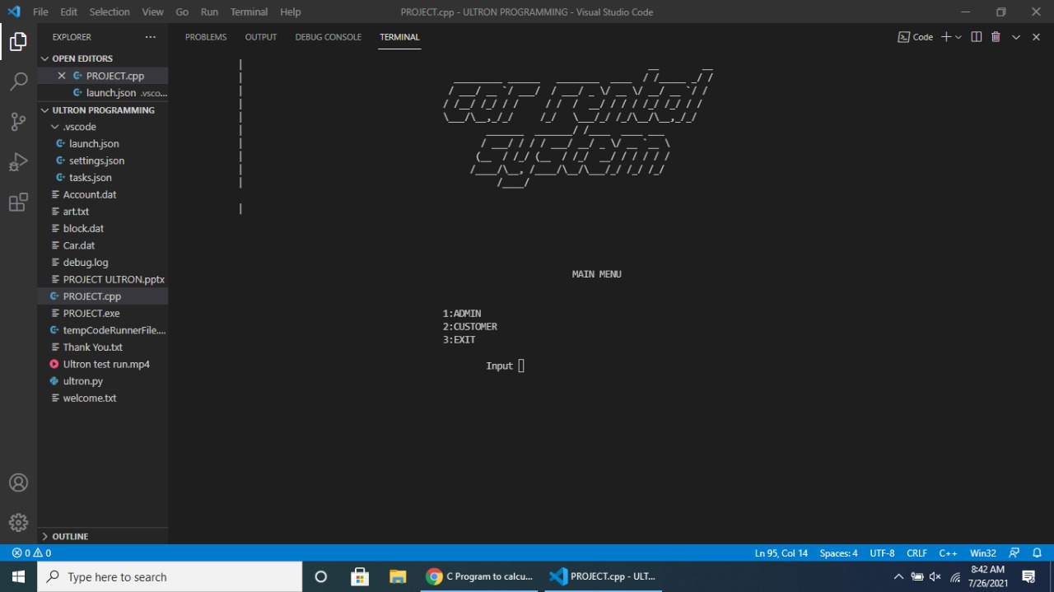
Results and Outputs
MAIN MENU

Slide 9
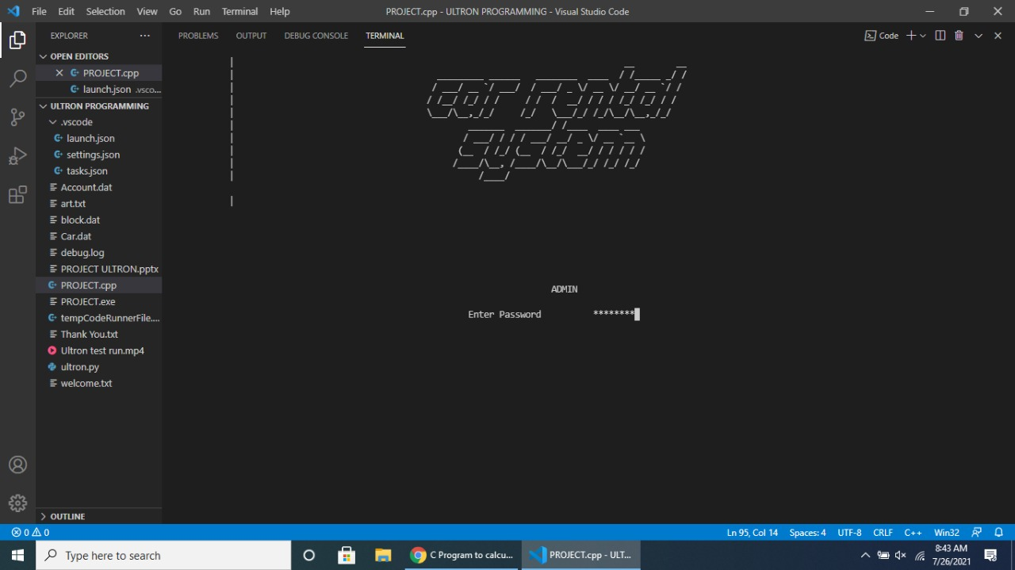
Admin Credential Login

Slide 10
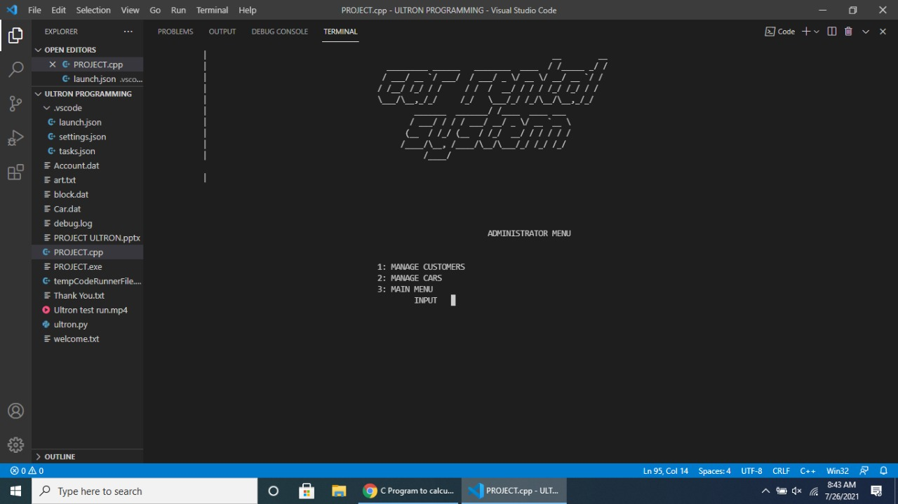
ADMINISTRATION MENU

Slide 11
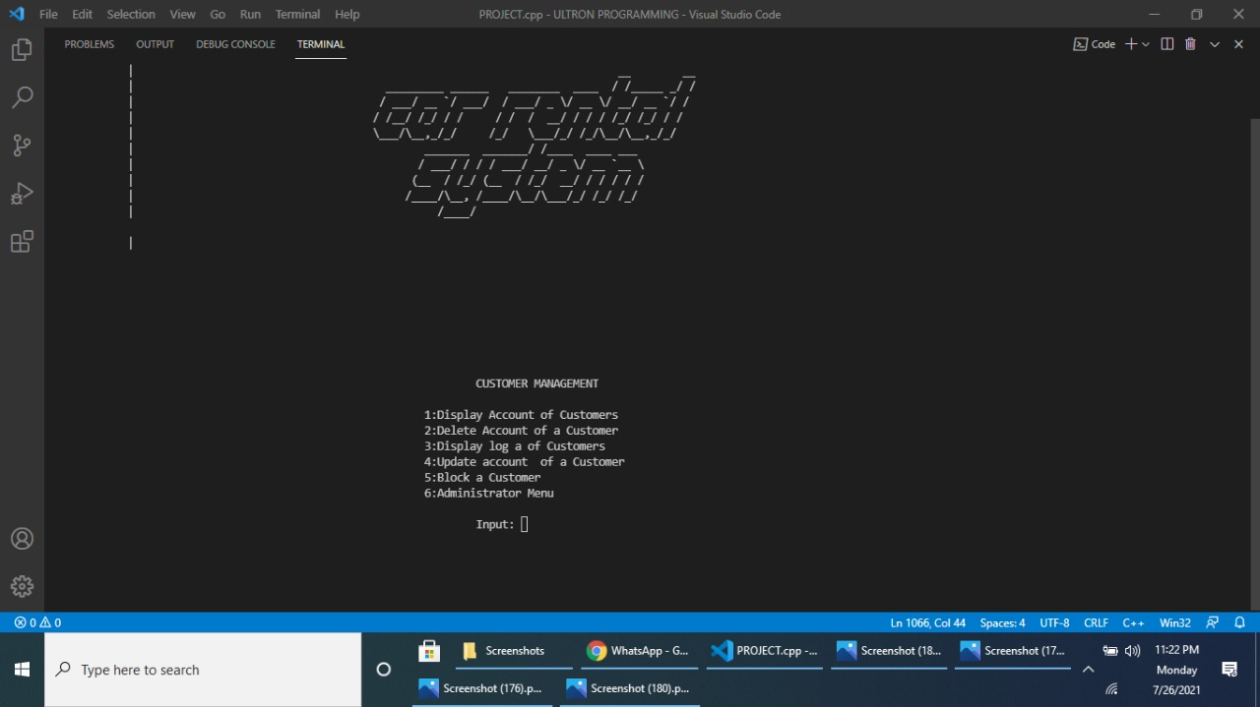
CUSTOMER MANAGEMENT

Slide 12
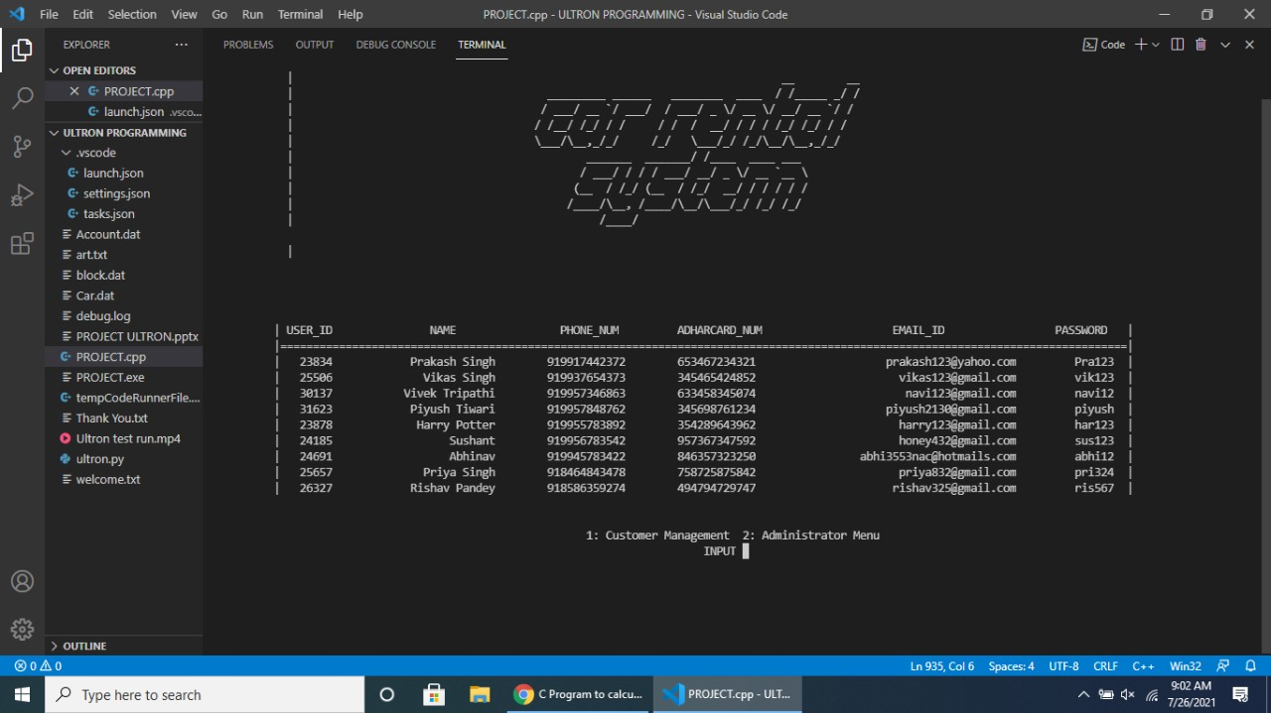
Account of all Customer

Slide 13
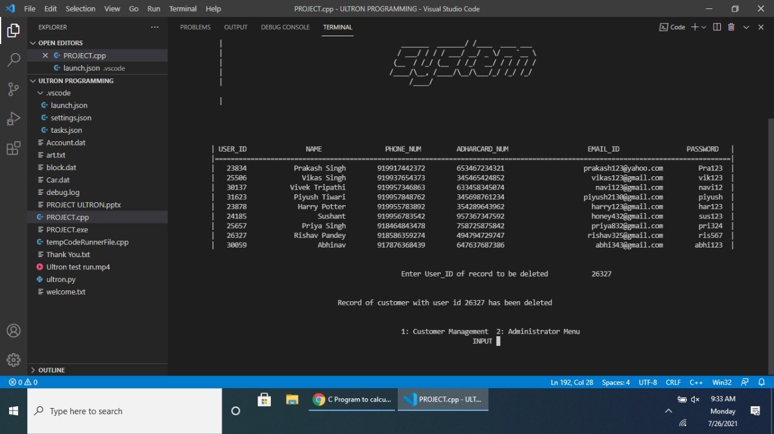
Customer Account Removing

Slide 14
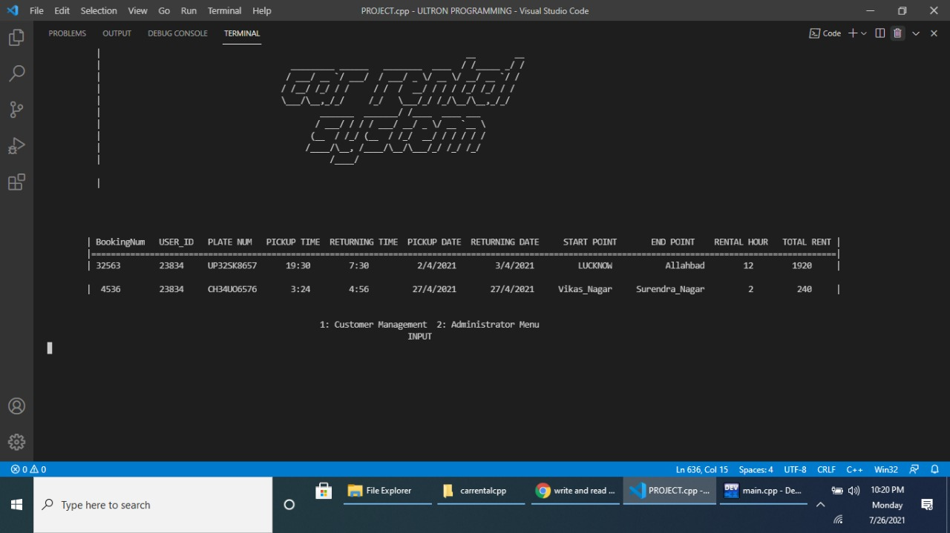
Customer’s Record

Slide 15
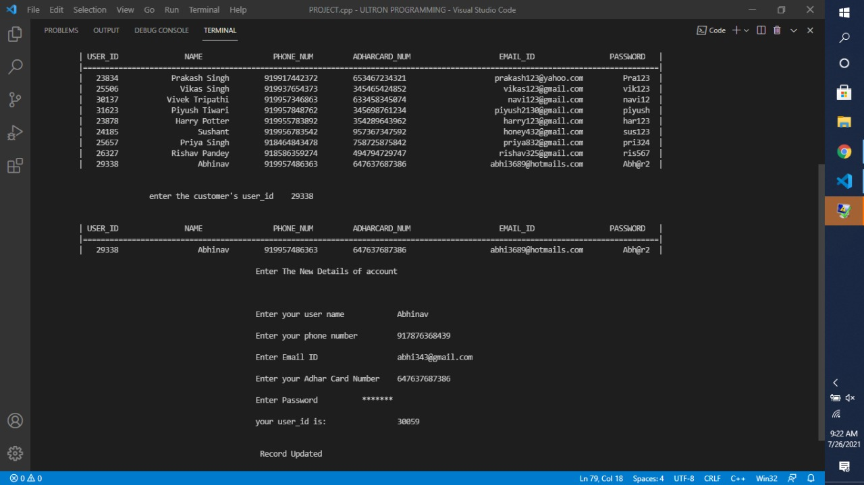
User Details Update

Slide 16
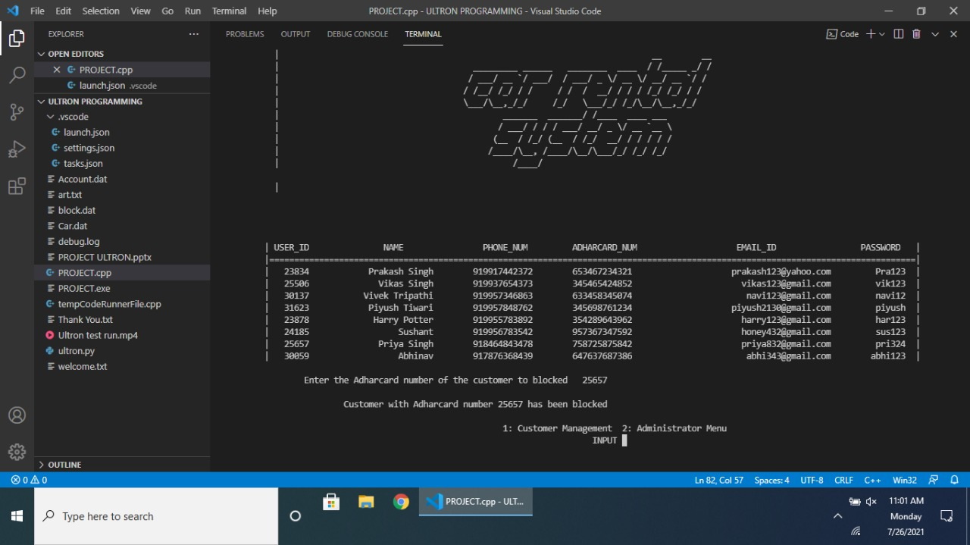
Account Termination

Slide 17
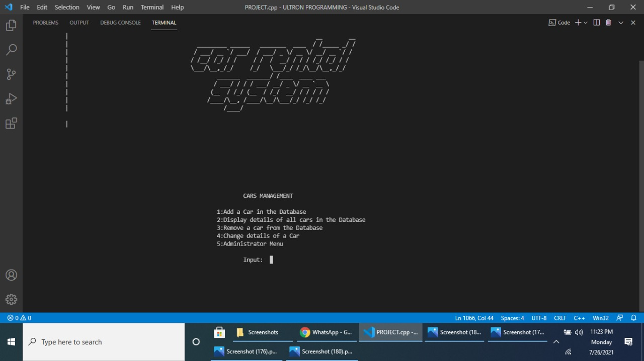
CARS MANAGEMENT

Slide 18
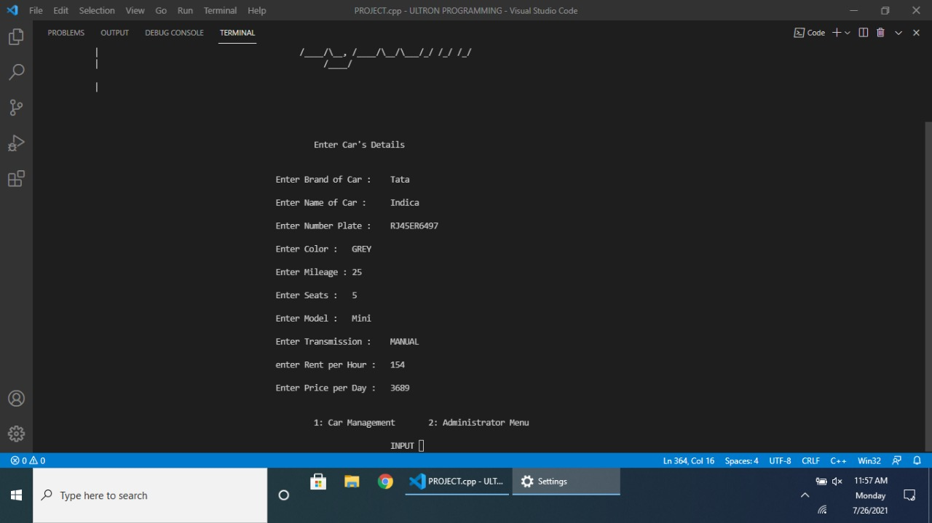
ENTERING DETAILS

Slide 19
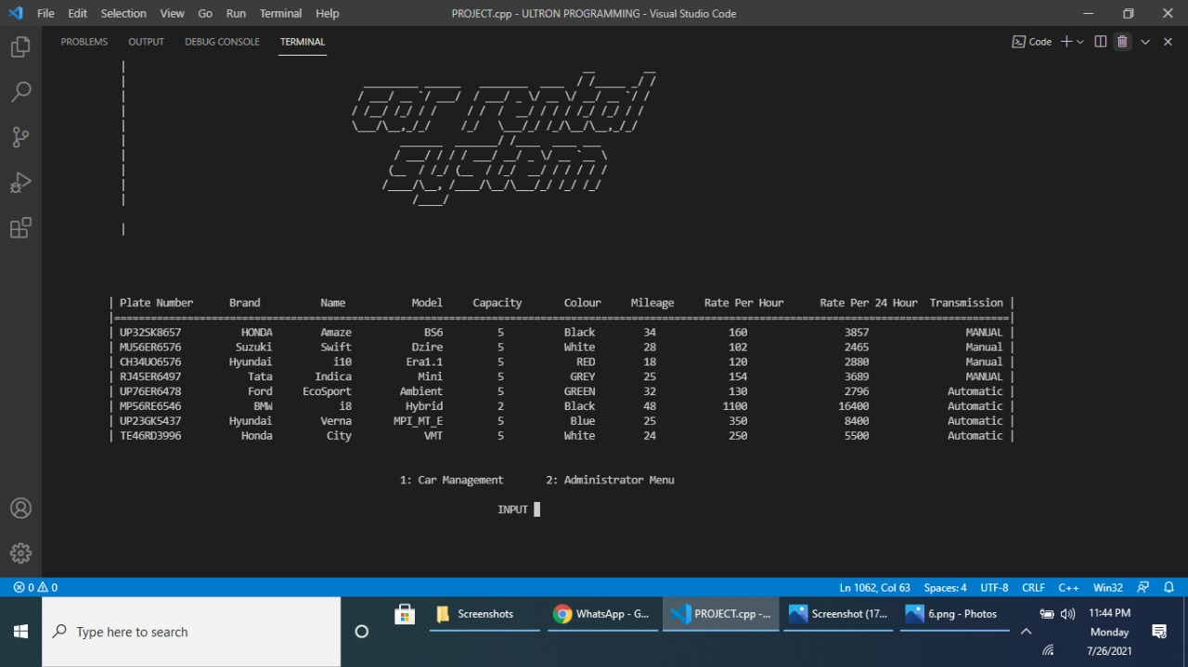
Car Records

Slide 20
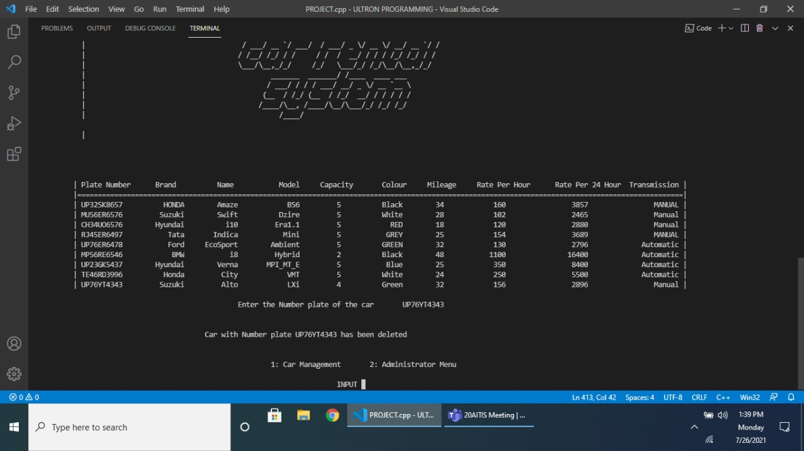
Remove car Details

Slide 21
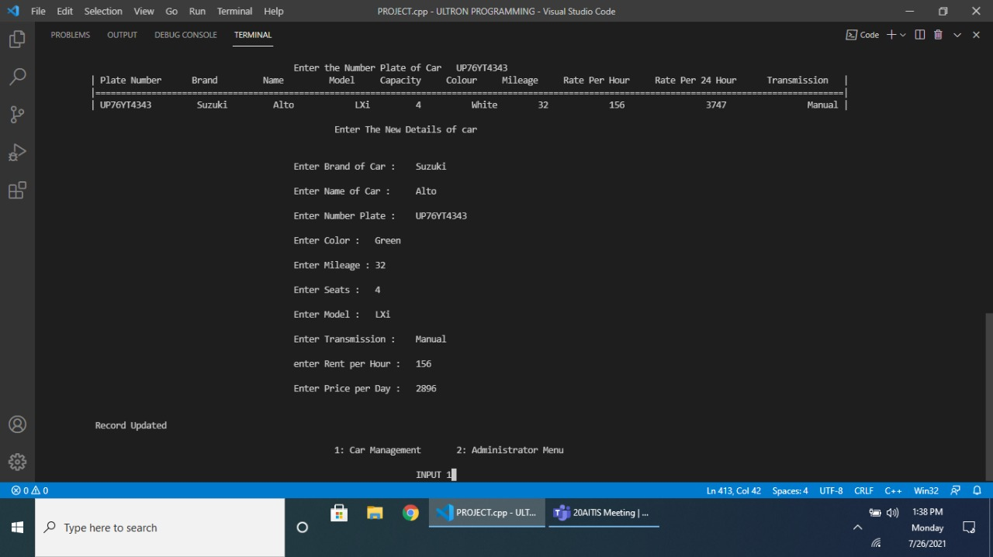
Car Details update

Slide 22
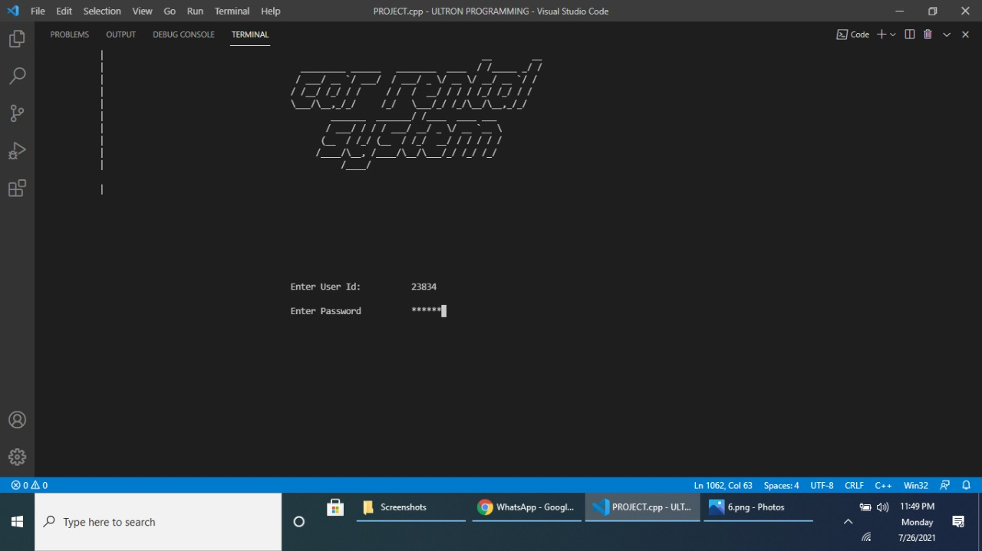
User Credential login

Slide 23
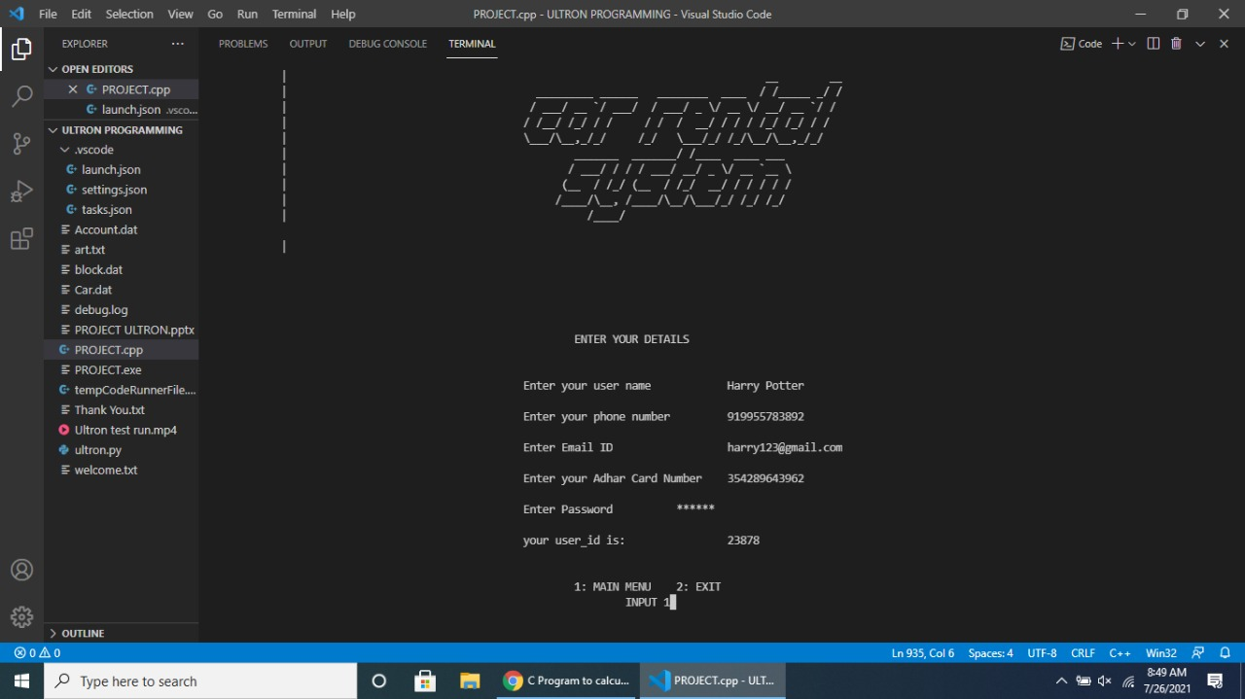
Account Making

Slide 24
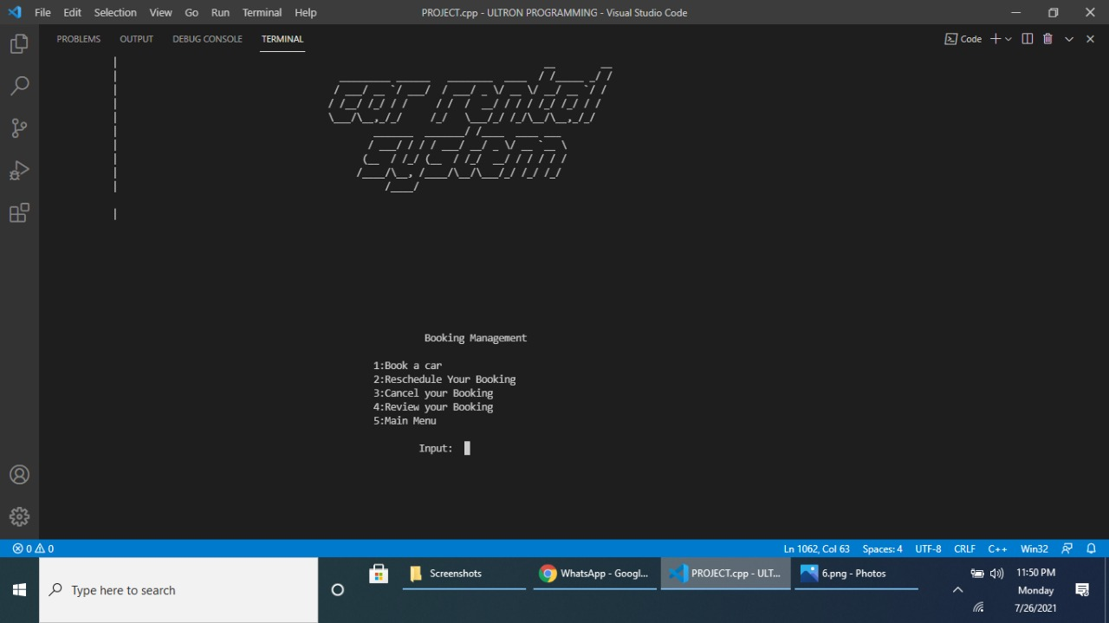
BOOKING MANAGEMENT

Slide 25
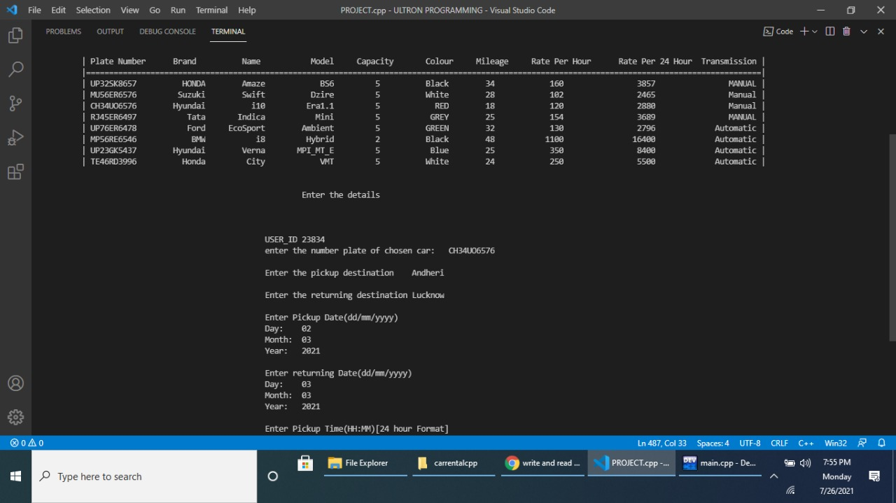
Booking Automobile

Slide 26
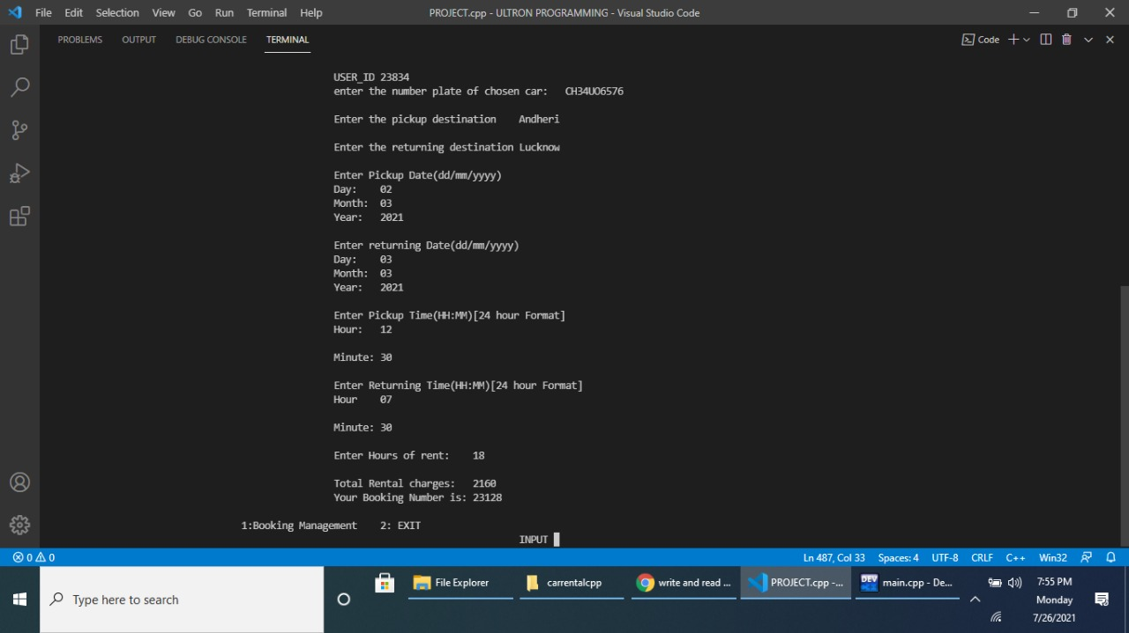
Booking Automobile

Slide 27
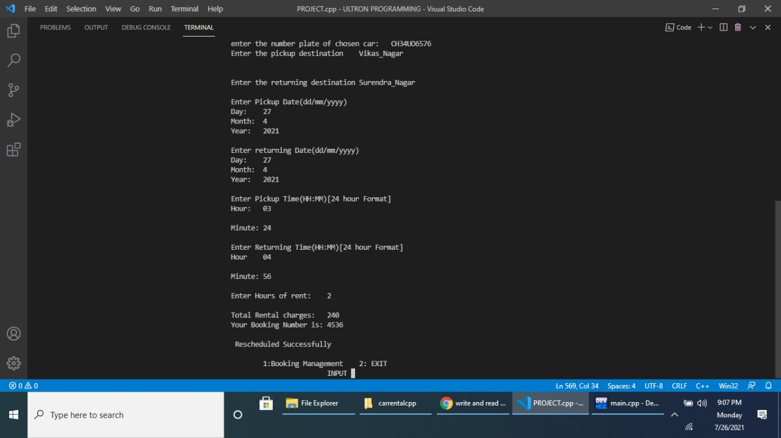
Reschedule Booking

Slide 28
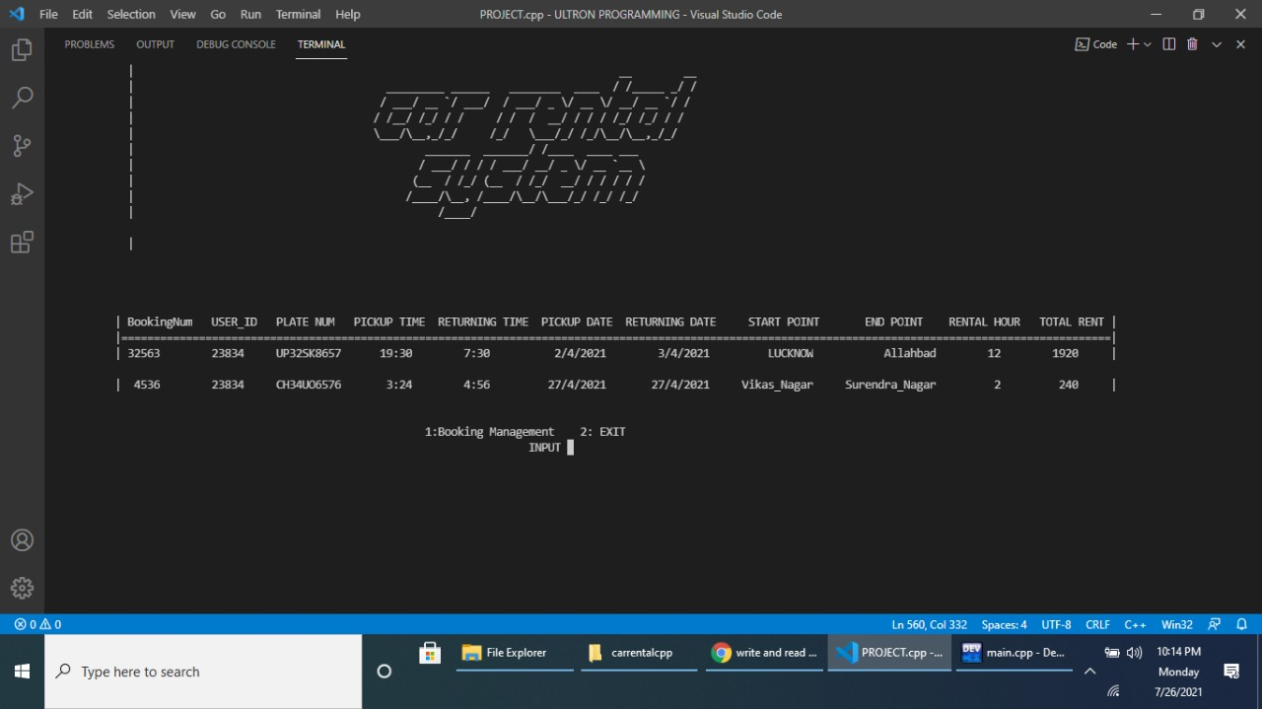
Booking Status

Slide 29
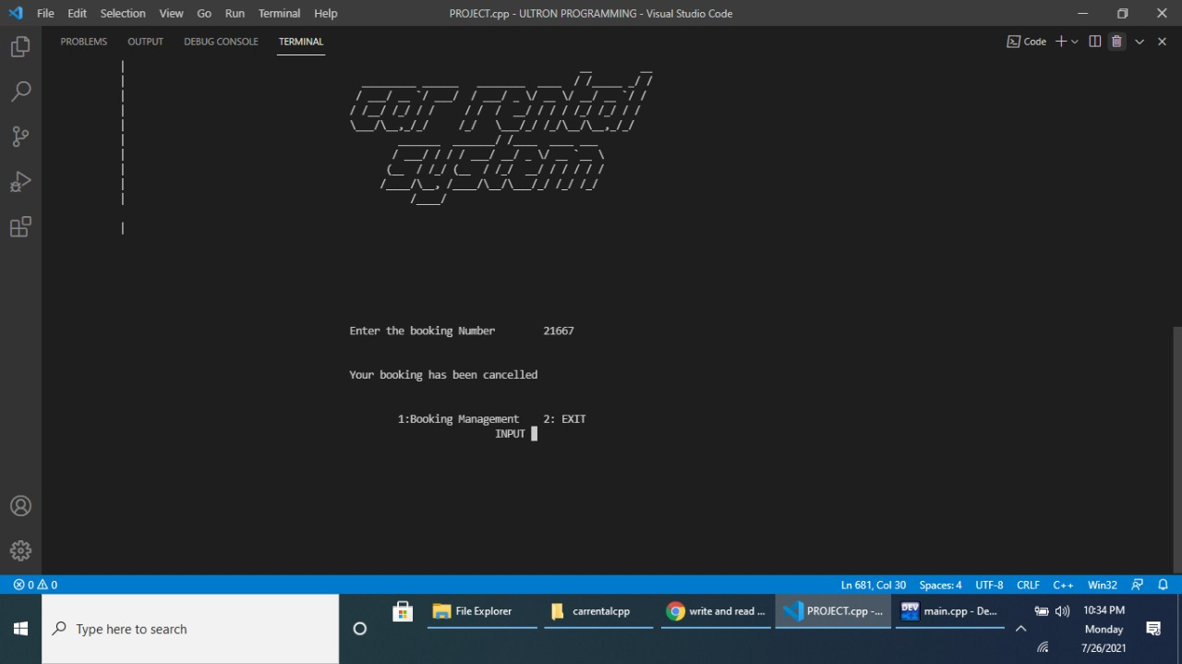
Booking Termination

Slide 30
Conclusion
This project minimizes the use of books and is easily accessible by just clicking on the button.
The project can be maintained for life-long purpose as the data can be edited, Deleted and added if required.
It basically aims at low cost, most durable, secure and Reliable user experience.
The project is done as efficient as Possible

Slide 31
Future Scope
Car Rental Business in the whole world growing rapidly. While several players have already entered and established themselves in the market, there is still scope for others. Every company is trying to provide better services and offers to get more reservations and this is bringing improvement and use of new automated technologies in the market. Now rental companies are focusing on customer support, training, sales and marketing to stand out clearly and to communicate better with the customers. This will increase the customer footfalls and sales.
Most of the car rental businesses are doing good and some of them are working hard on every facet to improve their services. We can expect a bright future for all car rentals who are implementing smart tricks and technologies to stand out in the market. To provide better services and automate the business, many car rental companies are using Car rental system

Slide 32
References
https://www.youtube.com/watch?v=jdGCzoxmLVA
https://hackr.io/blog/cpp-projects
https://www.w3schools.com/CPP/default.asp
https://stackoverflow.com/
https://github.com/

